Slide 1
FEM2401 Malaysian Politics and Society TOPIC 3: CULTURE, RELIGION, AND TRADITIONAL PRACTICES OF THE MULTI-ETHNIC SOCIETY
Lecturer: MUHAMMAD AMIR BIN MUNSHI

Slide 2
Learning outcome:
To describe the culture, religion and traditional practices of the society
To explain the social structure of Malaysian society (majority, minority and indigenous)

Slide 3
OVERVIEW
Multi-ethnic society
The majority
The indigenous
The minority
Multi-ethnic society
Religion
Culture
Traditional practices

Slide 4
Ethnic Composition in Malaysia before Independence
The three largest ethnic groups in Malaya are the Malays, Chinese, and Indians. Meanwhile, in Sabah and Sarawak, the Bumiputeras or natives form the majority, consisting of various ethnic groups.
In the beginning, the majority population of Malaya were the Malays (90%)
A small number of Chinese came to Malaya as traders.
Only a small number of Indians came to Malaya to work in the plantations, although some were here as religious teachers and traders
In the mid-19th century, an influx of Chinese and Indian immigrants to Malaya and Borneo
the influx of Chinese and Indian workers - The Chinese immigrants were brought using the system called Kangchu, meanwhile the Indian through the Kangany system.

Slide 5
British recruited and brought them to work in Malaya - to work in cash crop plantation (such as rubber, coffee and spices like pepper, gambir etc) and tin mining.
The composition of the society changed. Most of the Malays were in the traditional farming and fishing occupations, Indians were in the rubber plantations and Chinese in the tin mining
British rule created division of labour based on the ethnicity, with a particular economic role – also later impacted on the social and education system segmentation.
During British rule, the society were not much integrated and assimilated. The situation was similar to the description of J.S. Furnivall on the society in Myanmar in 1950s under British colonial.
J.S. Furnivall definition of a plural society – “A plural society is one in which many races or ethnic groups live side by side in separate geographical and sociocultural enclaves, meeting only in the marketplace.
The most significant impact of the British rule – the formation of multi-ethnic society.

Slide 6
The Concept of a Plural Society
According to JS Furnivall (1956) in his study on a number of countries in Southeast Asia, Plural Society means a society that consists of a variety of ethnic groups that reside within a political unit, but to not merge
The main factor for the plural society in Malaysia was the colonial policy that led to the mass migration of Chinese and Indians to Malaysia in the mid-19th century to work in the mines and estates
Plural society in characterized by Furnivall as: cultural diversity, physical separation, identification of ethnicity and economic function, lack of social contract, and one ethnic group dominating politics

Slide 7
THE MULTI-ETHNIC SOCIETY IN MALAYSIA
Currently (2020) Malaysia's population is about 32 million
Bumiputera (literally means sons of soil) or the indigenous - 69.9%
Malays 65%
Non-bumiputera
Chinese – 22.6%
Indian- 6.8%
Others (minority ethnic groups) – 0.7%
Malaysian citizens consist of the ethnic groups Bumiputera (67.4%), Chinese (24.6%), Indians (7.3%) and Others (0.7%).
Among the Malaysian citizens, the Malays was the predominant ethnic group in Peninsular Malaysia which constituted 63.1 per cent. The Ibans constituted 30.3 per cent of the total citizens in Sarawak while Kadazan/Dusun made up 24.5 per cent in Sabah.

Slide 8
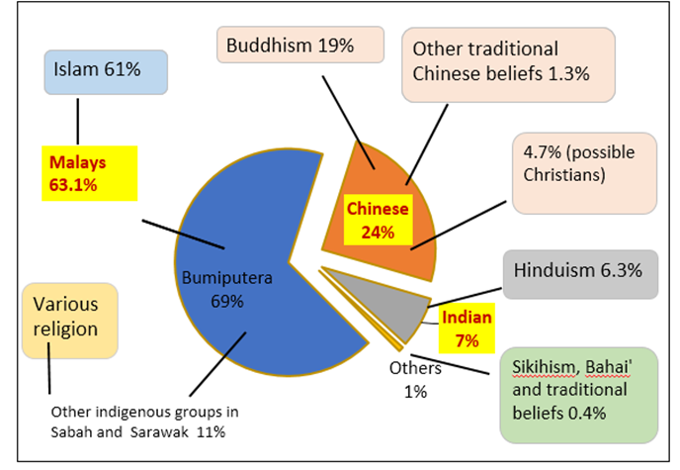
Ethnic/religious composition in Malaysia (2015 statistics)
Bumiputera (69%)
Malays (63.1%)
Islam (61%)
Other indigenous groups in Sabah and Sarawak (11%)
Various religions
Chinese (24%)
Buddhism (19%)
Possible Christians (4.7%)
Other traditional Chinese beliefs (1.3%)
3. Indian
Hinduism (6.3%)
4. Others
Sikhism, Bahai’ and traditional beliefs (0.4%)

Slide 9
THE MULTI-ETHNIC SOCIETY IN MALAYSIA
In brief, major (dominant) ethnic groups in Malaysia are the Malays, Chinese and Indian.
Bumiputera (Malays, Native of Sarawak and Sabah, and Orang Asli) – the largest group
Native of Sarawak: Iban (Majority), Bidayuh, Orang Ulu, Melanau etc
Native of Sabah: Kadazan-Dusut, Bajau, Murut, Suluk etc.
Major religions : Islam, Buddhism, Christianity, Hindu
The society of Malaysia – closely intertwined with ethnicity and religions. Most of the celebration and festivals are either religious or cultural in origin
LOCAL LANGUAGES
• 136 listed languages spoken in Malaysia (112 are indigenous)
• Bahasa Melayu/Malay (official)
• Chinese (Cantonese, Mandarin, Hokkien, Hakka, Hainan, Foochow),
• Indians (Tamil, Telugu, Malayalam, Panjabi
• Natives of East Malaysian – several indigenous languages such as Iban and Kadazan

Slide 10
Background of the Main Ethnic Groups in Malaysia
Malays
Chinese
Indians
Orang Asli
Other Ethnic Groups
Bumiputera of Sarawak
Bumiputera of Sabah

Slide 11
a) Malays
The largest and dominant community
The indigenous people of Malaya. There are many Malay sub-ethnic groups, mainly:
(i) Island Malays, originated from the Malay Archipelago, such as the Javanese, Banjar, Bugis, Boyan, Minangkabau, Acehnese, Kampar, Mandailing, Rawa and so on
(II) Peninsula Malays, those originating from the Malay Peninsula, such as the Kedah Northerners or those from the East Coast (Kelantan and Terengganu)

Slide 12
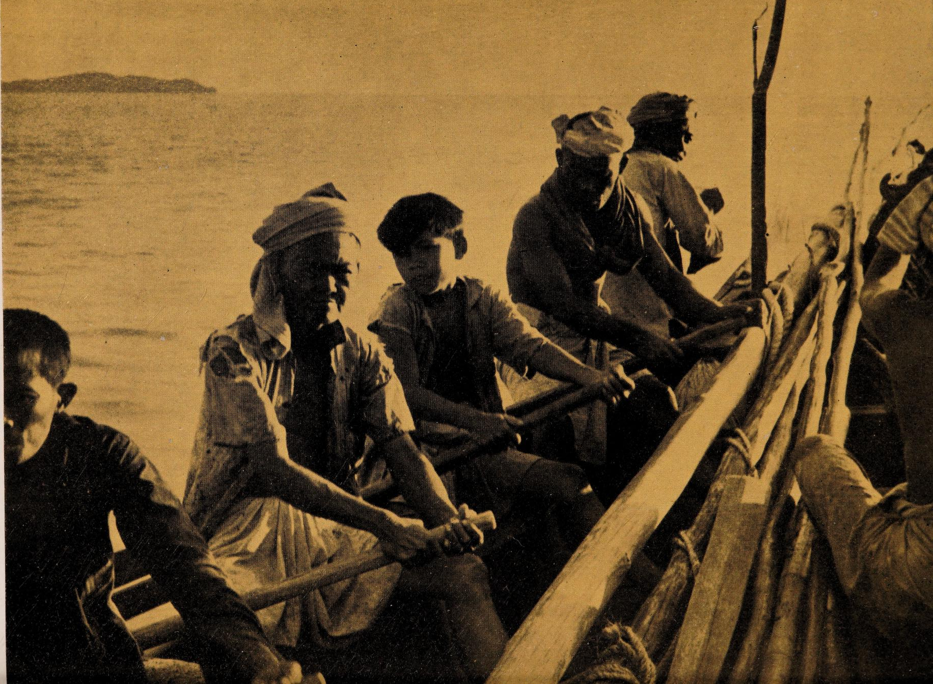
Dominant in politics – leading major political parties in Malaysia (UMNO, PAS, Bersatu/Pribumi and Amanah)
Islam is the religion – commonly associated with Islam – The Malays are culturally influenced by Islam and Malay custom/tradition - Halal certification in food and banking system
The image of Malay fishermen in the East Coast in the 1940s

Slide 13
THE MALAYS : THE CULTURE AND TRADITION
Festival: Main celebration - Eid-ul fitr and Eid-ul Adha, other Islamic observations based on Islamic calendar such as, Awal Muharram - the first day of Hijrah calendar, etc.
Malay culture and tradition is similar with Indonesian, Brunei and Malay in Singapore and Thailand - it came from the same root.
Traditional food similar with the Malays in Singapore and traditional cuisine in Indonesia and Brunei
Traditional attire – Baju Kurung (female)(few types of baju kurung based on the state) and Baju Melayu (male)

Slide 14
b) Chinese
Second largest ethnic group - major non-indigenous group
In history – besides in tin mining, they were involved in trading and commercial activity. Most of them were from southern provinces of China
After independence – the Chinese dominant in trading and commercial business – economic power
Politically dominant after the Malays – contribution during the process of the Malaya independence. The political party - Malaysian Chinese Association (MCA)
Ethnic tension between the Malay and Chinese yet also influence of the culture and tradition on the Malays and vice versa

Slide 15
THE CHINESE: THE CULTURE & TRADITION
Largely adherents of Buddhism and Taoism. Language based on the sub-ethnics groups - Hokkien, Hakka, Cantonese, Teochew and Hailam. A number of the Chinese also embraces Christianity
Peranakan or Baba Nyonya – minority/sub-ethnic group – result of mix-marriage between Chinese and Malay during Malacca empire
Festival and celebration: Chinese New Year, Chap Goh Mei, Ching Ming, Hungry Ghost, Wesak Day (Buddhist), Tanglung or Lantern Festival or the Mooncake Festival, Dragon Boat Festival etc.
Traditional attire – Samfoo, Cheongsam (female) and Tang Suit (male)
Traditional food – Southern China influence, from the community of Cantonese, Hokkien and Szechuan

Slide 16
c)INDIAns
Most of them originally from Southern India (Tamil Nadu and Kerala) and settled in Malay Peninsular. They were mostly recruited to work as workers in the rubber, tea and oil palm estates. They were lived mainly in plantation estates on the west coast.
Among them – there are differences in terms of culture and tradition.
Most of them are Hindus, a number of them are Christians. Language - Tamil, Telugu, Malayalam and some Hindi.
Also includes a sizeable number of Sikh minority community – were recruited by British in paramilitary and police units.
The Indians also contributed to the process of Malaya independence – Malayan Indian Congress Party (MIC)

Slide 17
THE INDIAN: THE CULTURE AND TRADITION
The Indian celebrates two main festivals (one of the major Malaysian festivals)
Deepavali - the festival of lights
Thaipusam - an annual fair of the Hindu deity Murugan - held at Batu Caves, Selangor
Other smaller religious events every year such as Thai Ponggal (harvest celebration – celebrated more in the rural area as compared to the urban)
Malays and Indian shared similar culture in terms of food and other culture – due to the influence of Hinduism in the ancient days and the traders during the Malacca empire. Influence of Indian cuisine on the Malays - has resulted in the creation of a variety of popular dishes. Popular cuisine – Mamak food

Slide 18
Similar to Baba and Nyonyas, there are amalgamation/mix-marriage between the immigrants and local - the Chitty community in Malacca and Muslim Peranakan (Jawi Pekan) in Penang. Chitty - they remain Hindu, adopts the Malay and Chinese culture and speak Malay. Their women dress in sarong kebayas instead of sarees. Jawi Pekan are Muslims.
Indian traditional attire - Most Indian women wear saree and blouse. Indian men wear kurta-pyjama, dhoti-kurta or lungi-kurta. Sherwani – a type of kurta during wedding or festivals.

Slide 19
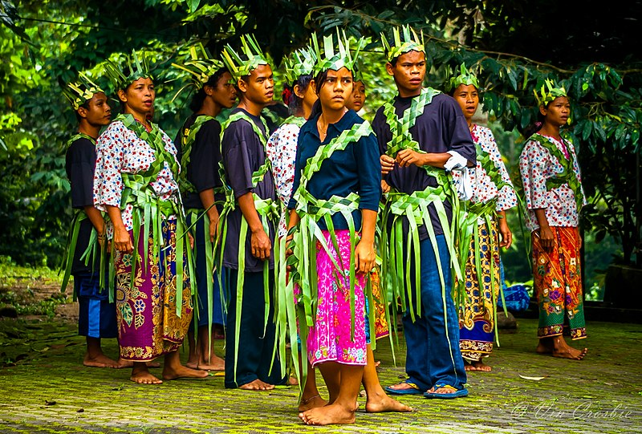
d) Orang Asli
The Orang Asli are the indigenous people of Peninsular Malaysia
Consists of at least 19 sub-ethnics, divided into three large groups:
Negrito (Semang) – Kensiu, Kintak, Jahai, Lanoh, Mendriq, Batek
Senoi – Semai, Temiar, Jah Hut, Che Wong, Mah Meri, Semaq Beri
Melayu-Proto – Temuan, Semelai, Jakun, Orang Kanaq, Orang Kuala, Orang Seletar, Temoq
Image of an modern-day Orang Asli

Slide 20
e) Other Ethnic Groups in Malaya
Aside from Malays, Chinese, Indians, and Orang Asli, there are also other ethnic minority groups in Malaya, such as:
Eurasian
Straits-Born Indian/Chitty
Straits-Born Chinese/Baba-Nyonya
Siam/Thai
Ceylonese

Slide 21
I) Bumiputera of Sarawak
Sarawak also known as Bumi Kenyalang (it means Land of the Hornbills), has about 30 different ethnic groups - population of more than 2.6 million
The largest ethnic - the non-Muslim native communities are collectively called Iban (or Sea Dayaks) most of whom are Christians or practise animist beliefs. Bidayuh – the second largest ethnic group.
Others include the Kenyah, Kayan, Kedayan, Murut, Punan, Bisayah, Kelabit, Berawan and Penan.
Dayaks who live in the interior of Sarawak are sometimes referred to as Orang Ulu (or people from the interior). Dayaks typically live in longhouses and practise shifting cultivation – some also live near a river and do fishing.
The Iban language is widely spoken that many non-Ibans, including Malays and Chinese – Iban language is not the same as the Sarawak Malay language.
The festival of Hari Gawai or Gawai Dayak is a celebration of the Dayaks to mark the end of the paddy harvesting season (harvest festival)- also marks the beginning of the new planting season, and activities such as dancing, singing, and a considerable amount of drinking tuak (rice wine) take place in the longhouses.
The festival Kaul - celebrated by the Melanau fishermen, they sail miniature wooden boats into the sea, an offering to the spirits.

Slide 22
Ethnic Group | Background
Iban | Lives in all parts of Sarawak (especially around the river banks)
Bidayuh | Focused in Serian, Kuching, Bau, and Lundu
Malays | Lives in downstream of river valleys
Melanau, Kadayan, Bisaya’ | Coastal areas
Land Dayaks and Sea Dayaks | Lives in plains
Orang Ulu such as Kelabit, Murut dan Pekan. | Mountainous areas
Orang Penan | Nomadic lifestyle and in forest
Orang Kelabit | Focused in the Baram River and Rejang River. Their famous village in Bario

Slide 23
ii) Bumiputera of Sabah
33 indigenous groups communicating in over 50 languages and 80 ethnic dialects.
Kadazan-Dusun - the largest ethnic group in Sabah - almost 30% of the total population. The Bajaus, or also known as "Cowboys of the East", the second largest, and Muruts, and third largest ethnic group.
Other indigenous tribes include the Bisaya, Brunei Malay, Bugis, Kedayan, Lotud, Ludayeh, Rungus, Suluk, Minokok, Bonggi, the Ida'an, and many more. The Chinese makes up the main non-indigenous group of the population.
Pesta Keamatan or the Harvest Festival is the most celebrated holiday of the year by the Kadazan-Dusun to honor the Rice Spirit and to give thanks for a bountiful harvest. Celebrate annually on 30th & 31st May

Slide 24
Ethnic group | Background
Orang Kadazandusun | Live in hinterland Focused in the Ranau and Tambunan valleys
Orang Bajau | from Mindanao and Sulu islands Also known as the Orang Laut Focused in Semporna, Kota Belud, and Pulau Timbang in Sandakan Bay
Orang Murut | Live in hinterland such as Tenom, Rundu, and Pensiangan Some still live in longhouses and are nomadic
Orang Suluk | from Sulu islands and focused at Sugut River Are Muslim
Brunei Malay | From Brunei, live in Beaufort, Kimanis, and Papar Are Muslim

Slide 25
ETHNIC MINORITY
Sikhs or also known as Punjabi – an important minority group in Malaysia – Celebrate festival, the Sikh New Year called Vasakhi, each April and the birthdays and martyrdom of Sikh Gurus.
The amalgamation of the immigrants with local community since Malacca empire and also during colonial rule
Chitty (Indian and Malays – non Muslim)
Baba Nyonya (Chinese and Malays- non Muslim)
Serani (Eurasians – Portuguese and local)– mix marriage of Portuguese and local

Slide 26
CONCLUSION
The multi-ethnic society of Malaysia is an inherited of the long history
Malaysia is rich culture and traditions.
The assimilation and amalgamation of the culture and celebrations – food, dress, language etc.

